Slide 1
Perspectives asbl
Flemalle (prov. Liege)
Philippe Juzwik (trainer) – Bruno Schneider (director)
Project « Digital Stage Technology »
PReSENTATION

Slide 2

Background
9 pre-qualifying trainings - 200 people each year
Wallonia Accreditation – Forem Partnership
Initiation into sound & light : 9 months (October -> June) – 12+ trainees

Slide 3
Project « Digital Stage Technology »
Orientation youth U25 : 8 of the 12
Poorly educated and/or long-term unemployed

Slide 4
STAGES
October to December: project to create an automated show
Basics in Electricity – Math – IT
« Learning to learn »

Slide 5
SUPPORT FOUNDATION P&V
60 % equipment investments
40 % course organization

Slide 6
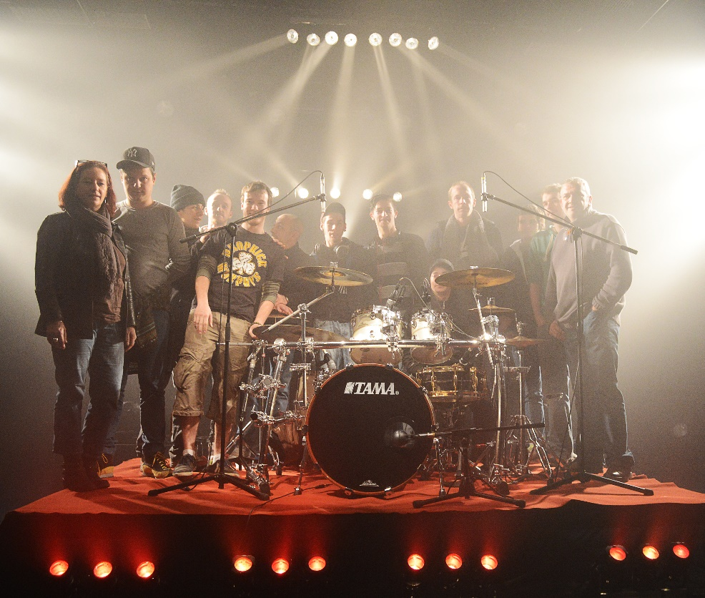
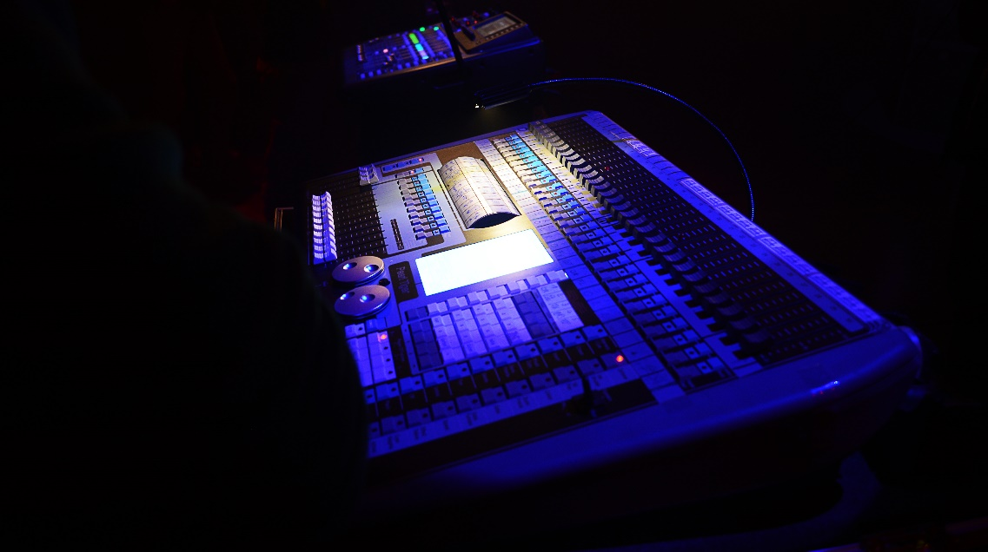
PHOTOS - VIDEO

Slide 7
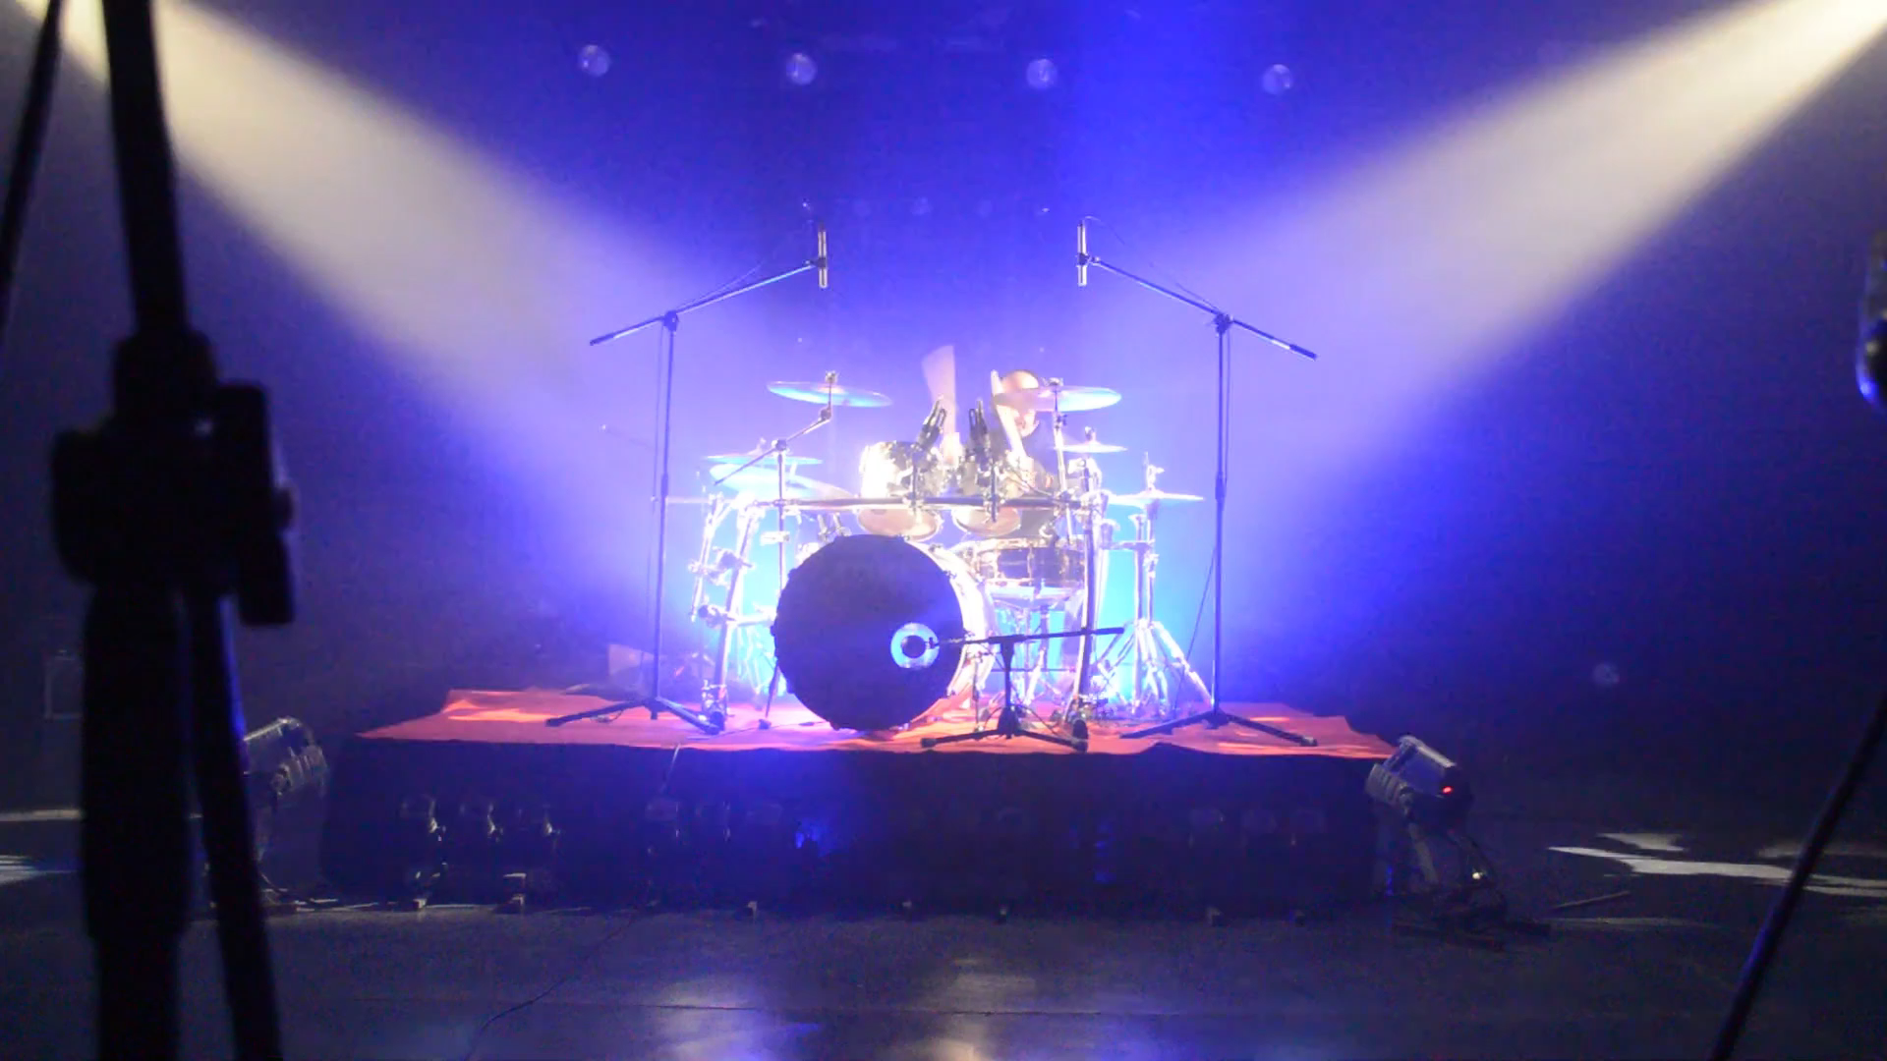
PHOTOS - VIDEO

Slide 8
RESULTS
Positive points
Negative points

Slide 9
PROPOSALS
Use the interests of young people in order to work their skills
Build bridges between the youth sector and integration sector / educational and social-professional

Slide 10
Contact
PERSPECTIVES – BE 0425.429.330
Place Émile Vinck, 2/10-13 à 4400 Flémalle
+ Centre culturel de Flémalle
Phone : 04/231.33.37
E-mail : info@performat.be
Website : www.performat.be

